Slide 1
Flipping In or Flipping Out? Is Flipping for Your Classroom?
Tiffany Lewis ● First Annual Higher Education Flipped Learning Conference ● Wednesday, June 8, 2016

Slide 2
tlewis-irsc.weebly.com

Slide 3
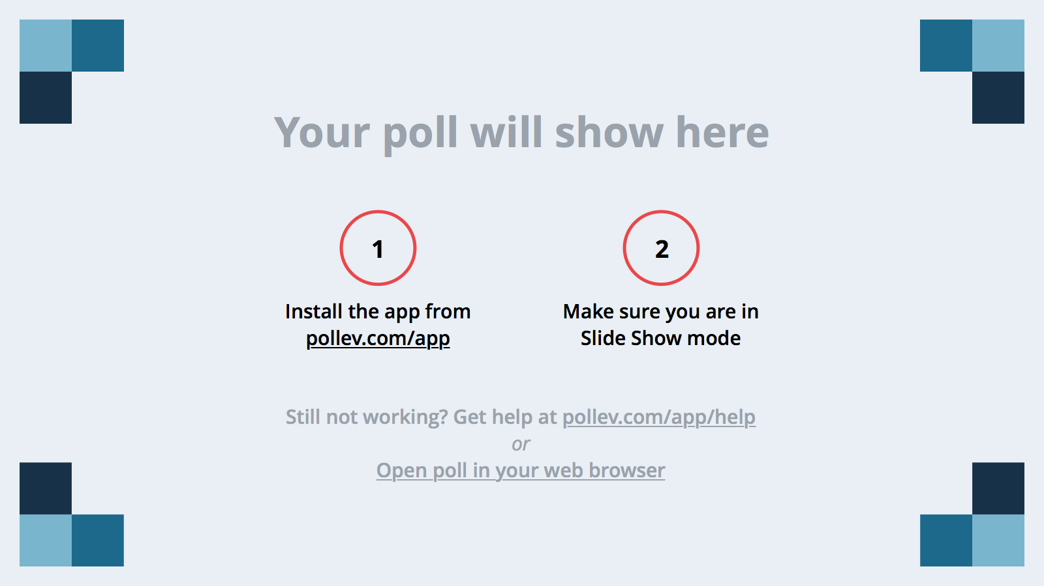
Notes:
Poll Title: What question would you like to ask the presenter to answer after the presentation? https://www.polleverywhere.com/free_text_polls/LnD2XcVg2tuZ21H

Slide 4
1.

Slide 5
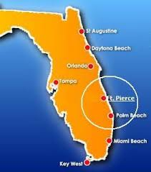
Location: Fort Pierce, FL
Established: 1959
Type: State College
Mascot: Pioneers
www.irsc.edu

Slide 7
Florida’s State
Legislature
Senate Bill 1720,
requires restructuring of remedial college preparatory instruction (developmental education) and requires Florida College System institutions to "provide developmental education that is more tailored to the specific communication and computation skills a student needs to develop to be successful in performing college-level work" (The Florida Senate, 2014).
requires that colleges will no longer be able to require recent high school graduates to take the state’s standard placement test or to enroll in noncredit remedial courses.
requires colleges to offer developmental education options a student may pursue while also enrolled in college-credit courses.
developmental education can be defined as modularized, compressed, contextualized, or co-requisite coursework.

Slide 8
SACSCOC Southern Association Of Colleges and Schools Commission on Colleges
Accreditation is reviewed every 10 Year
Quality Enhancement Plan (QEP)
Course redesign of Intermediate Algebra (MAT 1033)
Identify the Problem:
Students’ failure to progress through math gateway courses
The Research Project:
Improve student learning and success in math gateway courses

Slide 9
DELIVERY OPTIONS
SE – Supplemental Emporium
VM – Virtual Mastery
FE – Flipped Emporium
TR – Traditional Classroom
CL- Collaborative Learning

Slide 10
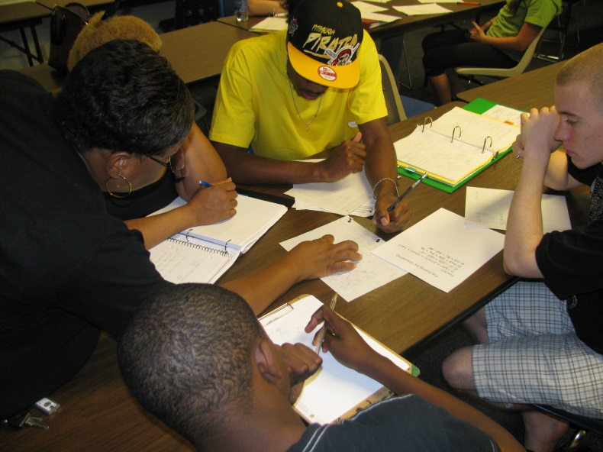
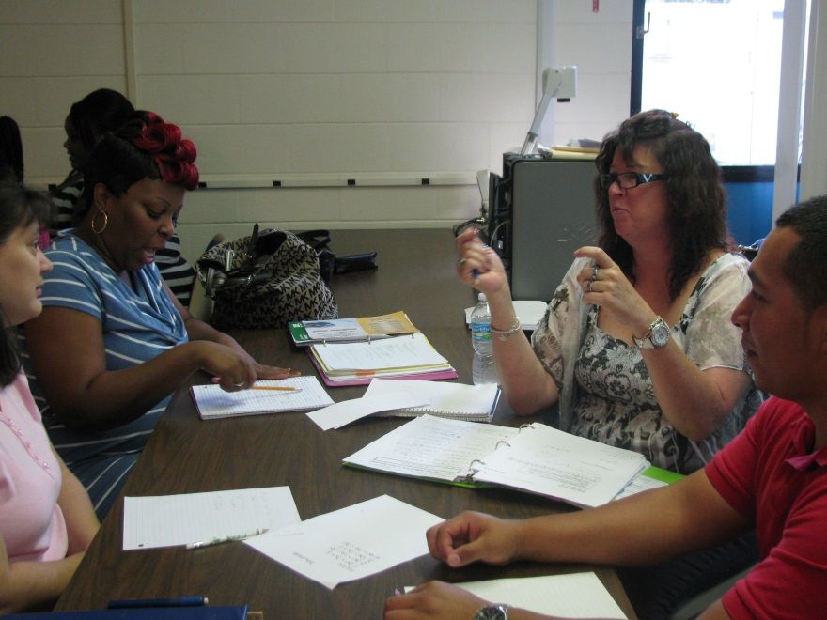
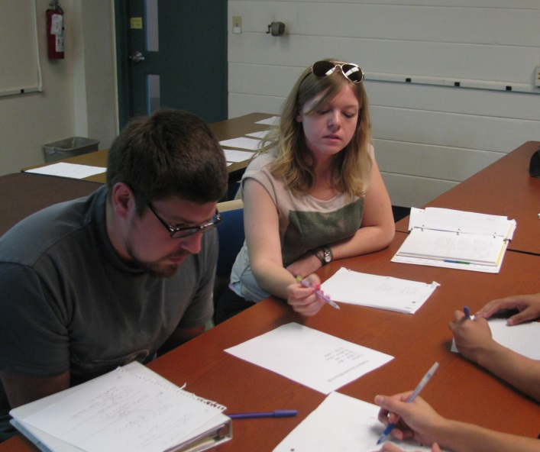

Slide 11
What NOT to Do?
2.

Slide 12
What NOT to Do?
Rush
Create long video lectures
Come into a flipped class without a plan/schedule/activities
Leave students without expectations
Expect that ALL students have access to a computer
Under estimate the amount of in class activities needed
Use old/outdated technology
Use handouts only

Slide 14
What TO Do?
3.

Slide 15
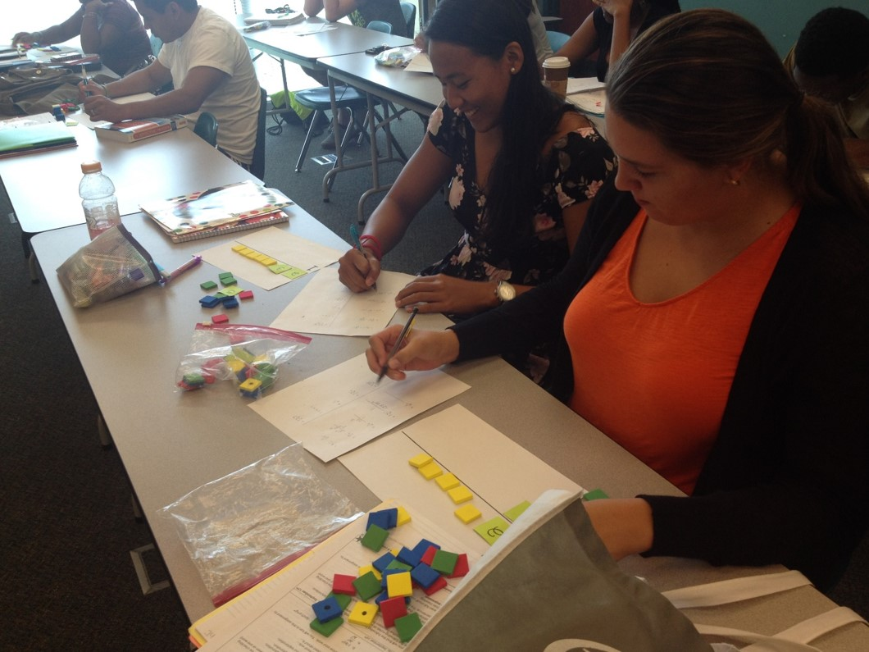
Research
Books, Articles, Published Dissertations
Websites
Conferences/Workshops/Webinars
Social Medial Outlets
What TO Do?

Slide 16
Training/Professional Development
Books on Flipped Learning:
by Jonathan Bergmann and Aaron Sams
The Flipped Learning Series:
for English Instruction
for Science Instruction
for Social Studies Instruction
What TO Do?

Slide 17
Training/Professional Development
Websites:
Flipped Learning Network flippedlearning.org
Flipped Learning: Turning Learning on Its Head flipped-learning.com
Flipping with Kirch flippingwithkirch.blogspot.com
Flipped Learning Journal www.flippedlearningjournal.org
Turn to your Neighbor: The Official Peer Instruction Blog. By Julie Schell http://blog.peerinstruction.net/
Education Dreamer http://www.educationdreamer.com/
Educational Technology and Mobile Learning http://www.educatorstechnology.com/
What TO Do?

Slide 18
Training/Professional Development
Conferences/Workshops:
FlipCon 2016 (flippedlearning.org): July 19 – 21
The Flipped Classroom 4 Week Online Workshop by Kelly Walsh, Author/Founder of EmergingEdTech http://www.emergingedtech.com/
ISTE 2016 Conference, June 26 – 29, Denver, CO
Social Media Outlets:
Twitter: https://twitter.com/flippedlearning
Facebook: The Flipped Class Network
Blog: #Flipclass Chat
Podcasts
Radio Show: The Flipped Side hosted by Jon Bergmann
What TO Do?

Slide 19
Types of Flipped Classrooms
Traditional Flipped
Flipped Mastery
Peer Instruction Flipped Classroom
Inquiry Flipped Classroom
Problem Based Learning Flipped Classroom
What TO Do?
Notes:
Traditional Flipped: In a traditional flipped class, the instructor assigns the video lecture(s) as homework for the students to watch the lesson of the day. Then the next day in class, the students are given homework questions to work on by themselves or in a group setting. When teachers get comfortable with this pedagogy, then they may move to the other flipped learning styles.
Flipped Mastery: This method allows students to work at their own pace. On the next day in class, the student works the same way as the traditional flipped. The only difference is that the student takes an assessment and must pass the assessment let’s say with an 80% mastery. If the student fails the assessment, then the student must go back, relearn the material and take the assessment again.
Peer Instruction Flipped Classroom: In a peer instruction class, students are still required to learn the material outside the class. Then in the class, the instructor presents some multiple choice questions on the board. For about ten to fifteen minutes, students work together and during that time they try to convince each other why their answer is correct. As a group, they work together or agree as a group that they have the right answer. Then the instructor reviews the question(s).
Inquiry Flipped Classroom: In an inquiry flipped classroom, students are engaged in activities that help them actively pose questions, investigate, solve problems, and draw conclusions about the world around them (Inquiry Based Classrooms, 2015).
Problem Based Learning Flipped Classroom: In a problem based learning flipped classroom, the students learn to solve real world problems/applications in their school and community.

Slide 20
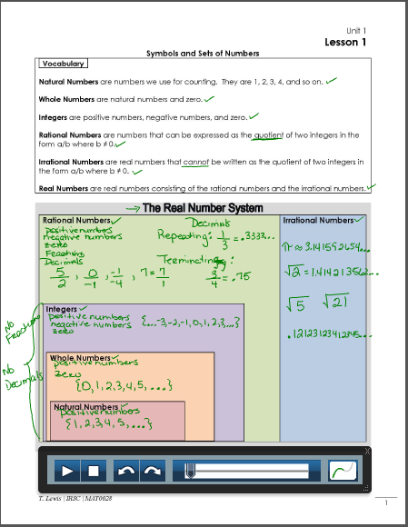
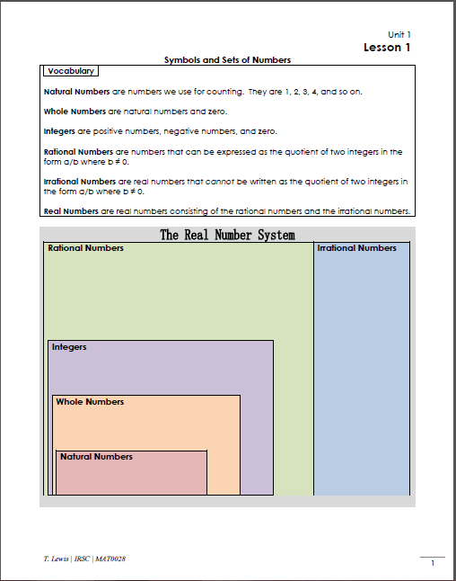
Start Slow
Start with one lesson
Take at least one semester to plan and create
Guided notes to 1 page (2 page max)
3 to 5 minute lecture videos
Save videos in all available formats
Policies and guidelines
Secondary website to store videos i.e. Weebly, Wix, YouTube
What TO Do?

Slide 21
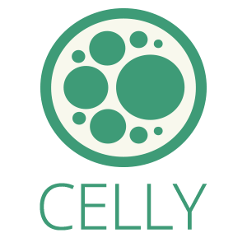
Assessments
Checking their notes for homework and class participation grade
Questionnaires i.e. Google Forms, Camtasia, LMS
Polling Tools
Polling Tools
Clickers
Cel.ly
Poll Everywhere
Plickers
Online Courseware i.e. MyMathLab
What TO Do?

Slide 22
What are the tools needed to flip a course?
Videos
YouTube or other video sharing sites
MOOCs
Screencasting/Recording Software
Camtasia
Jing (free)
Pen Annotation
Livescribe Smartpen
Interactive Whiteboard / Microphone
Kahn Academy
Make your own
Active Presenter (free)
Wacom Bamboo Tablet
SMART Board
Mimio
MS Office software
USB pen tablet
Tablet PC
Video Camera
Ipad/Iphone
Camera
IPEVO Doc Camera
SWIVL
Echo360
What TO Do?
Notes:
As an educator, there are video making tools needed to successfully flip their course. The tools are screencasting software, pen annotation, interactive whiteboard, webcam, recording software, video camera, and a microphone.
iClickers is another common electronic tool used in a flipped learning environment. iClickers are wireless handheld devices that provide the instructor with immediate feedback/data in the class. Students used the clickers to respond to classroom polls, quizzes, and even take attendance. In a flipped class, for instance, students are given a worksheet with practice problems in a small group setting. Using their clickers, students enters their answers, and the results are sent to the teacher. The teacher then shows the results on the overhead, and from the results, classroom discussion and a better understanding of the students’ comprehension of a topic that is and can be more accurately gauged, allowing a teacher to fine tune his/her lesson/teaching to accommodate the level of understanding, comprehension, and mastery.

Slide 23
“In the beginning of the semester I was very unsure about the flipped class style, but I have to say that, if I am given a choice in my future math classes, I definitely will choose a flipped class. I like that we do our homework in class and that you are there to help us master the concept when you are needed. In high school, I was unable to grasp the concept of algebra and felt that if I could not understand the homework, the next day I was left behind as everyone else went forward. While many teachers follow the same style of teaching year after year, it is refreshing to see one that grows with the times. Thank you for caring about your students enough to try a bold new approach that I think is helpful in many ways.”
“…the videos were very important to watch before class. It gives your mind a head start and you can take your time going through the lessons.”
“I am a visual learner so seeing you work out the problem and explain would really help and if I got confused still the next day you would go into more details and clear it up.”
“I find the teaching style very different and interesting. The atmosphere in class makes it very fun and comfortable to learn.”

Slide 24
thanks!
Any questions?
Tiffany Lewis
Indian River State College
772-462-7634
tlewis-irsc.weebly.com
tlewis@irsc.edu

